Slide 1

Puzzle Solver: Backtracking-Based N-Queens and
Sudoku Visualizer
LAB PART- B
Course: Design and Analysis of Algorithms
Department of Computer Science,
R V College of Engineering, Bengaluru.
NAME | USN
Aryan Gupta | 1RV23CS051
Arushi Vaidya | 1RV23CS049

Slide 2

Problem Statement
🧩Goal:
Design and build an interactive browser-based tool that visualizes backtracking algorithms for solving N-Queens and Sudoku, helping students understand DAA concepts through animation of recursive decisions and backtracking.
🔍Key Aspects:
Focus on constraint satisfaction problems
Real-time, step-by-step tracing
Educational and interactive design
RV COLLEGE OF ENGINEERING

Slide 3
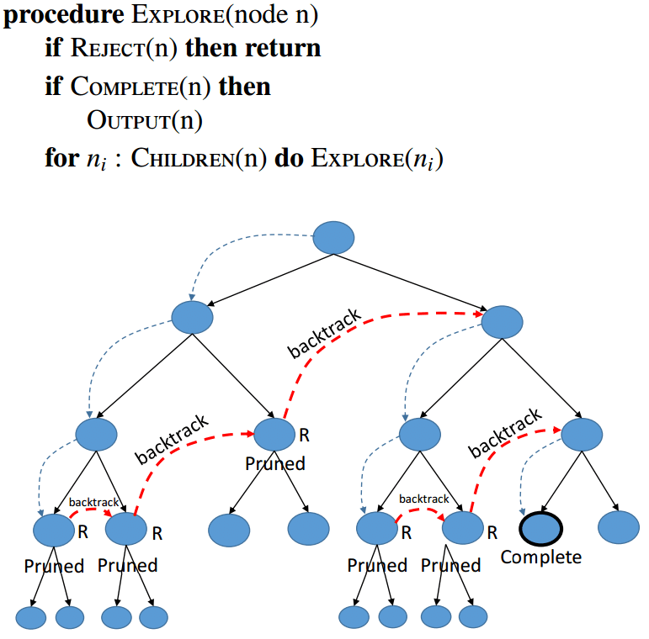
Introduction
🌀 What is Backtracking?
A recursive DFS approach that builds solutions incrementally and backtracks when constraints are violated.
🎓 Used in:
Solving Constraint Satisfaction Problems (CSPs)
Exploring large search spaces efficiently
RV COLLEGE OF ENGINEERING

Slide 4
Objectives
✅ Implement efficient backtracking
✅ Visualize recursion and decisions in real-time
✅ Track performance metrics: steps, depth, backtracks
✅ Build an intuitive front-end with React + TailwindCSS
✅ Aid in learning DAA through interactive simulation
RV COLLEGE OF ENGINEERING

Slide 5
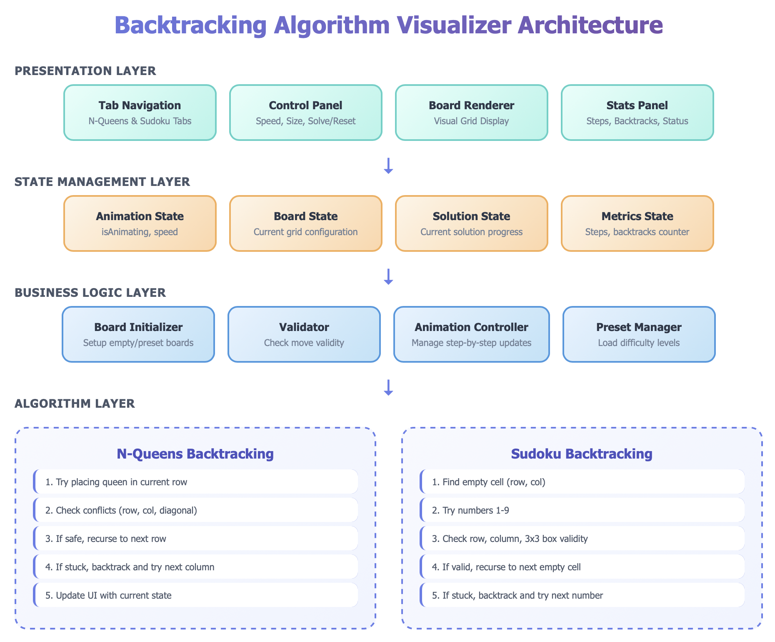
Methodology
RV COLLEGE OF ENGINEERING

Slide 6
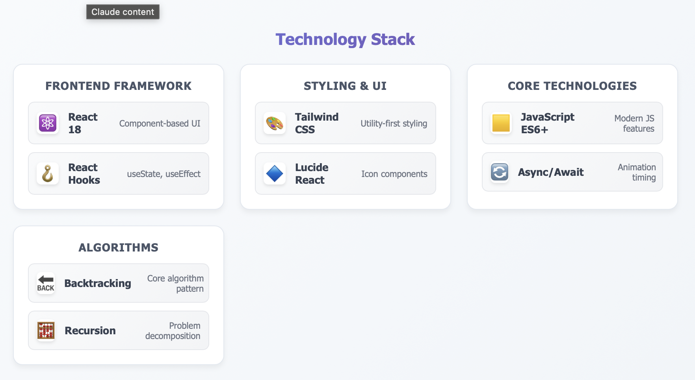
Methodology
RV COLLEGE OF ENGINEERING

Slide 7
Methodology
State | What Happens
User Input | Choose puzzle type, board size/difficulty, or manually edit grid.
State Init | React hooks (useState, useEffect) create the initial board.
Execution | On “Solve”, asynchronous backtracking begins; board state mutates and re-renders each recursive call.
Feedback | Live counters show steps, backtracks, placed queens/digits.
Speed Control | Slider sets animation delay (100 – 1000 ms).
Customization | Multiple board sizes (4×4, 6×6, 8×8) and Sudoku presets (Easy–Hard)
Responsiveness | Mobile/desktop layouts via Tailwind grid & flex utilities.
RV COLLEGE OF ENGINEERING

Slide 8
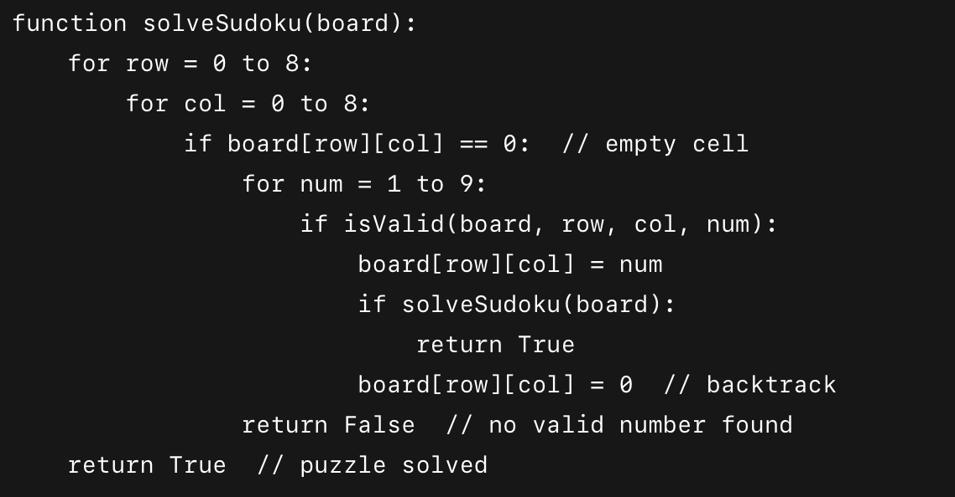
Sudoku Solver Algorithm(Back Tracking)
📐 9×9 Grid. Every row, column & 3×3 box must have 1–9 once.
Steps:
Find next empty cell
Try numbers 1–9
Place if valid, recurse
If fail, ❌ backtrack
Repeat until solved ✔️
RV COLLEGE OF ENGINEERING

Slide 9
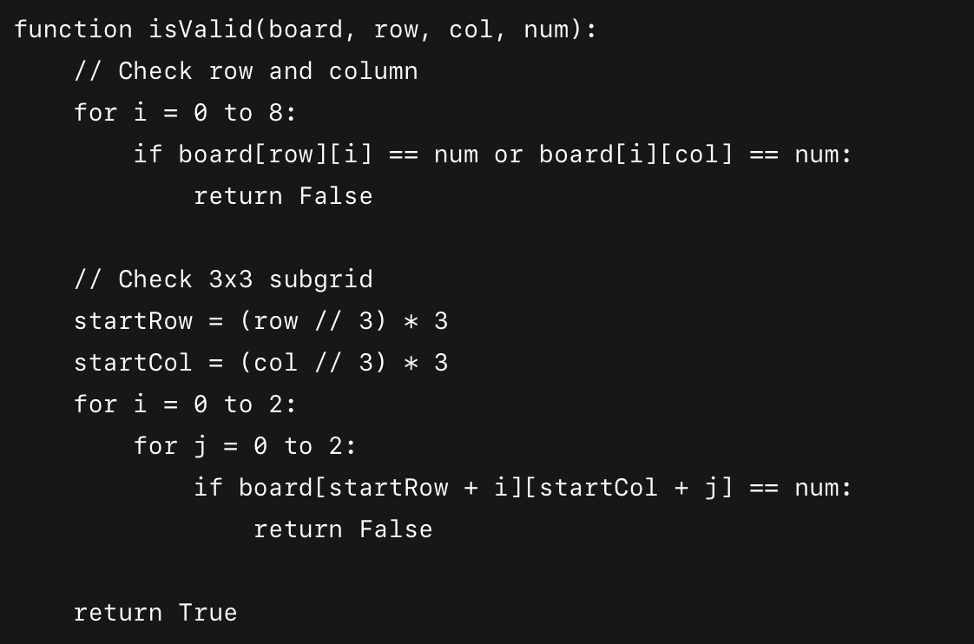
RV COLLEGE OF ENGINEERING

Slide 10
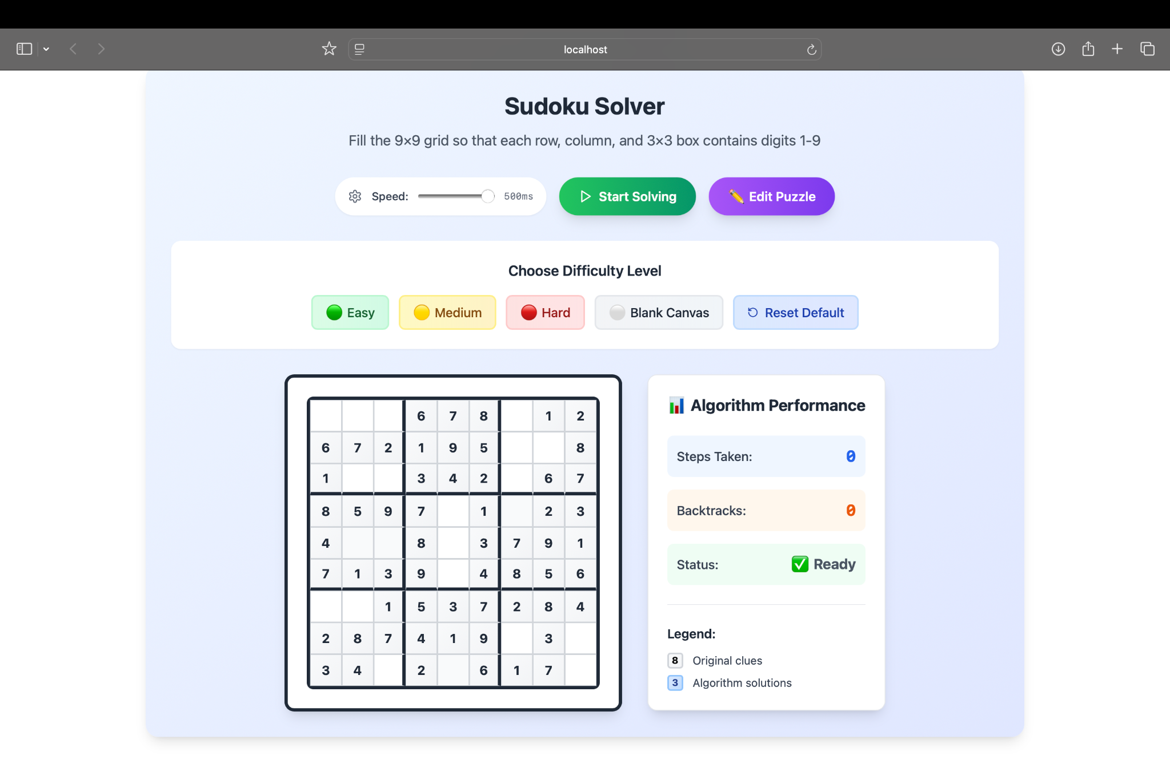
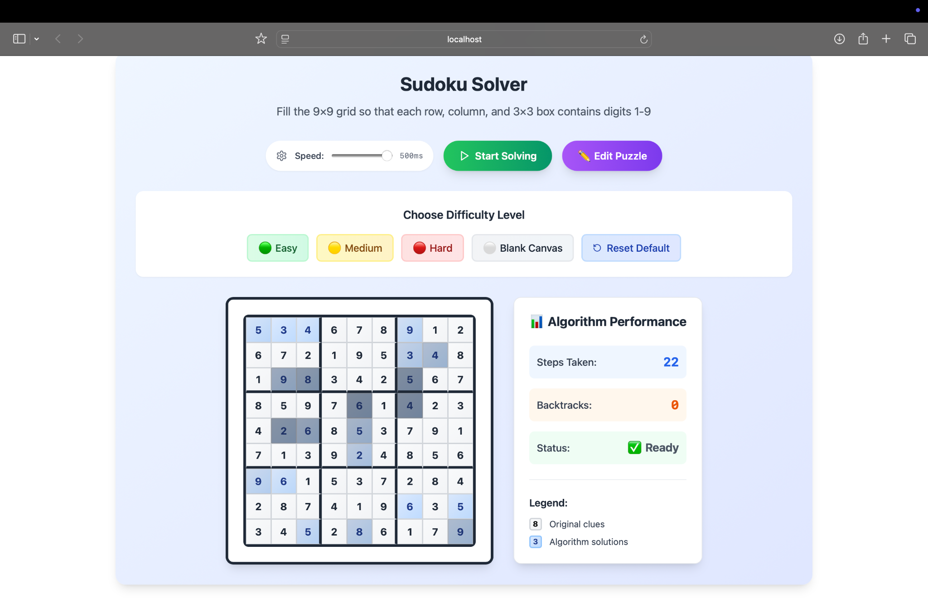
RV COLLEGE OF ENGINEERING

Slide 11
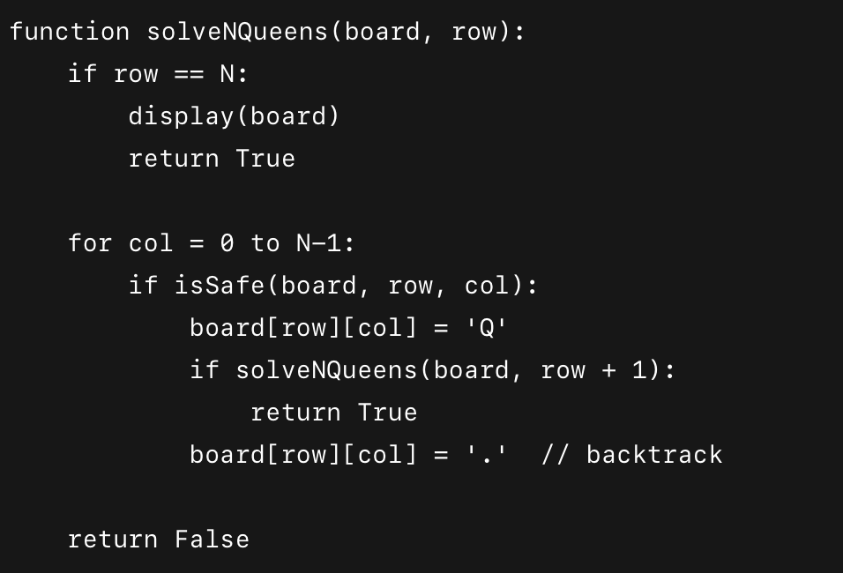
N-Queens Algorithm(Backtracking)
Place N queens on an N×N chessboard so no two attack each other.
Steps:
Start row-wise
Try placing a queen
Check column & diagonal threats
Recurse or ❌ backtrack
✅ Solution when all N placed
RV COLLEGE OF ENGINEERING

Slide 12
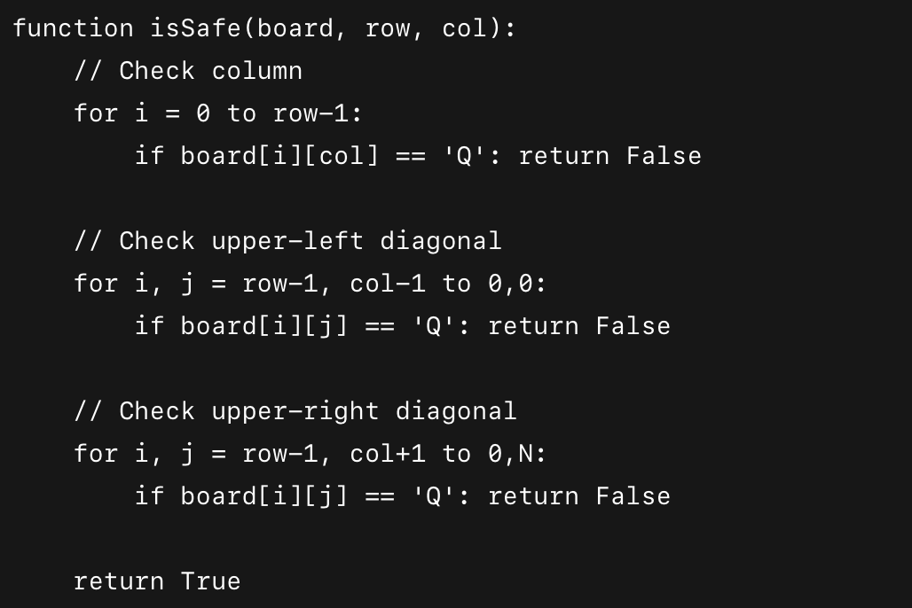
RV COLLEGE OF ENGINEERING

Slide 13
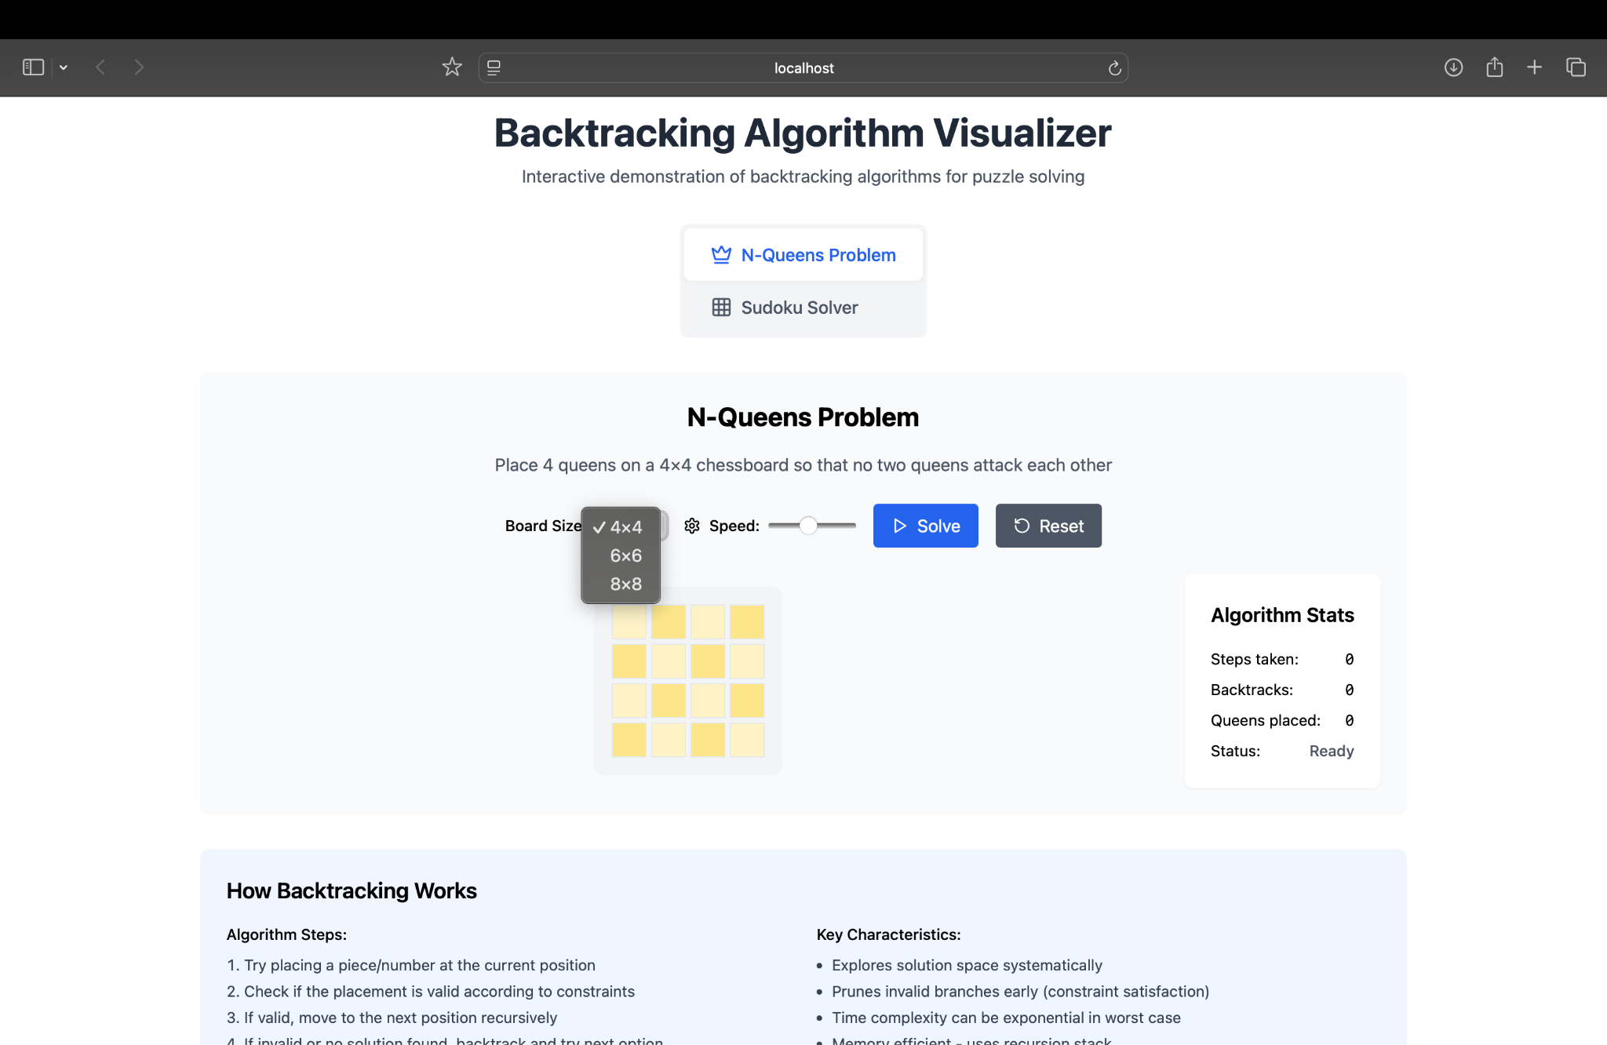
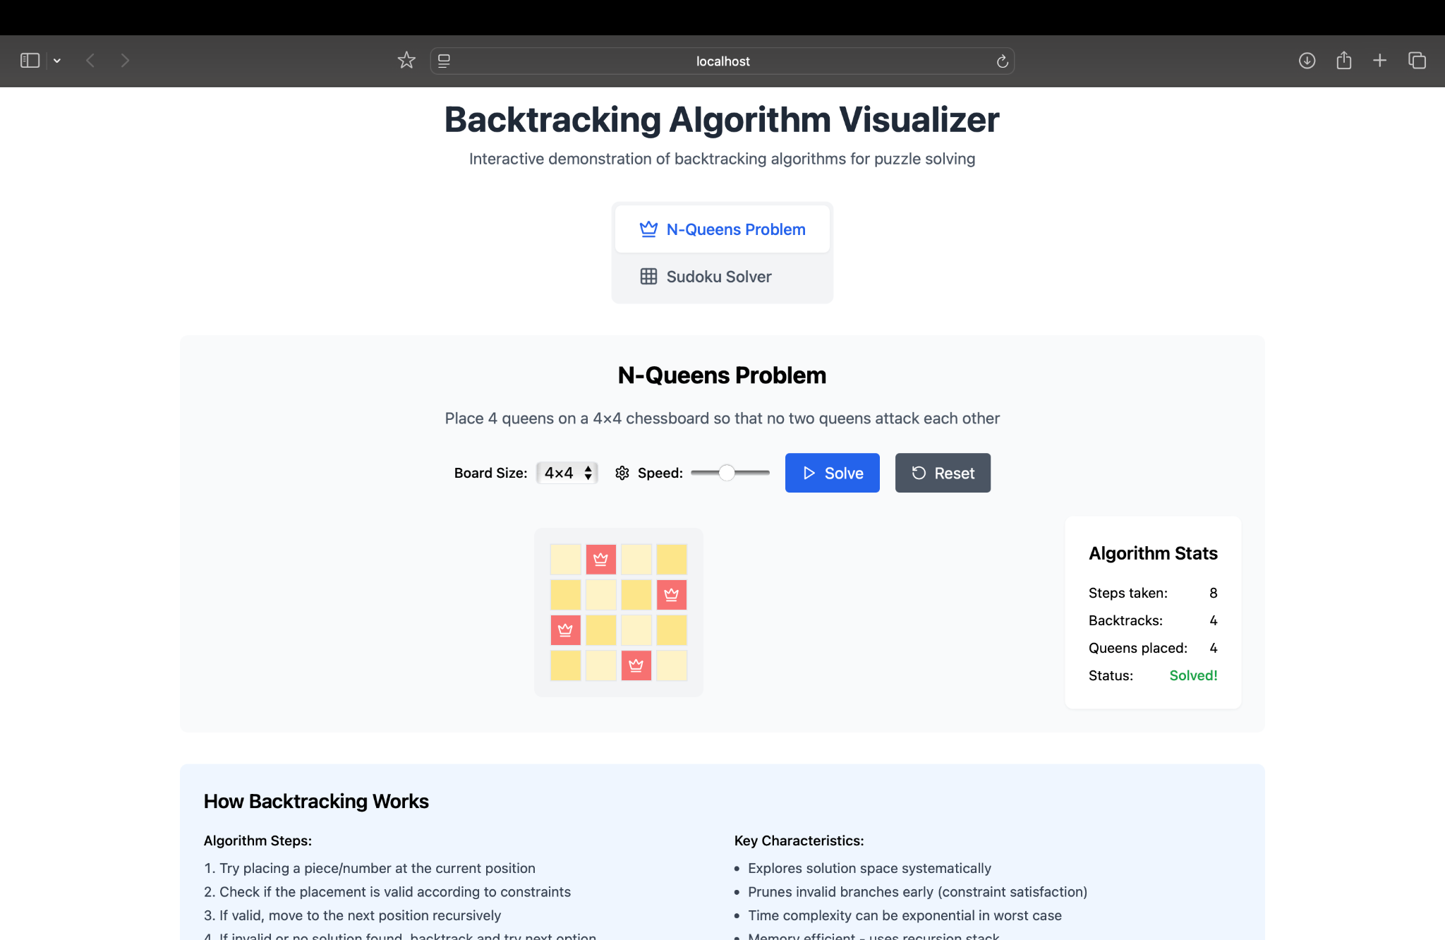
RV COLLEGE OF ENGINEERING

Slide 14
References
Cormen, T.H., Leiserson, C.E., Rivest, R.L., & Stein, C. Introduction to Algorithms (3rd ed.) – MIT Press, 2009.
Kleinberg, J., & Tardos, É. Algorithm Design – Pearson Education, 2006.
Norvig, P. (2006). Solving Every Sudoku Puzzle – https://norvig.com/sudoku.html
Russell, S., & Norvig, P. Artificial Intelligence: A Modern Approach (4th ed.) – Pearson, 2020.
ReactJS Official Documentation https://reactjs.org
TailwindCSS Documentation https://tailwindcss.com/docs
Lucide Icons for React https://lucide.dev
Mozilla Developer Network (MDN) https://developer.mozilla.org
RV COLLEGE OF ENGINEERING

Slide 15
Thank you
RV COLLEGE OF ENGINEERING

